Slide 1

“Digit Recognition with CNN and Model Optimization using Batch Normalization and Dropout Layer”
Term1 Final Project
PRESENTED By:
Anil Dhakal (C0898886)
Sanat Kumar Upreti (C0898884)
Syed Roman Uddin(C0906298)
Ujjwal Khatri (C0899849)
PRESENTED ON: 19TH AUGUST 2023

Slide 2
Agendas for Presentation
Introduction
Problem Statement
Objectives
Background
Data Extraction and Exploratory Analysis
Data Preprocessing
Model Selection and Development
Training and Validation
Data Visualization
Results and Discussion
Demo Works
Conclusion and Future Recommendations
References

Slide 3

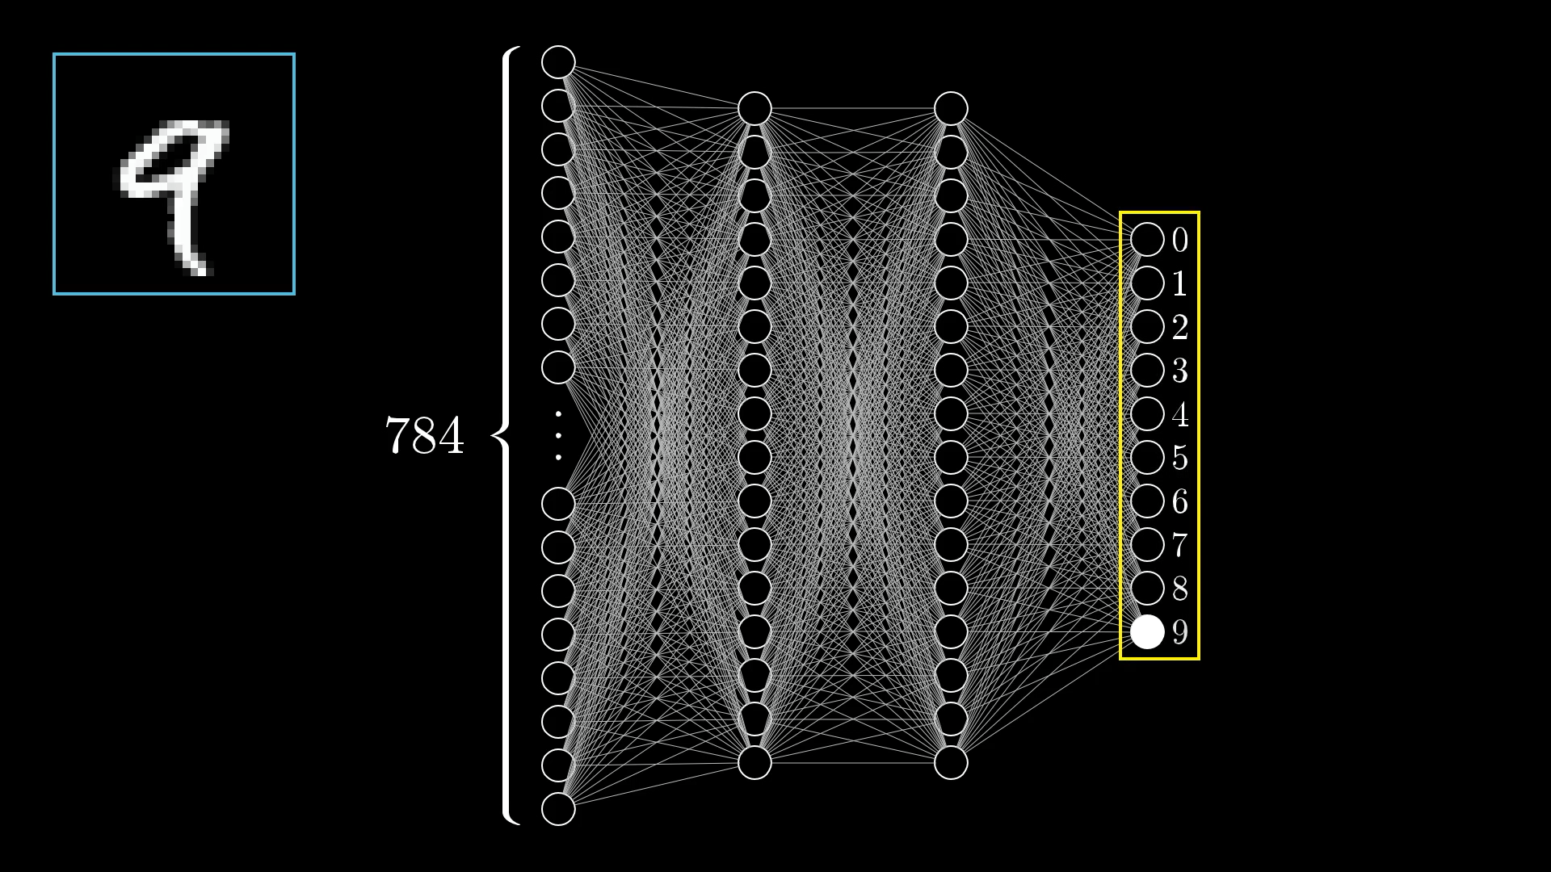

Introduction
Identifying and classifying handwritten or printed digits (0-9) from images accurately and precisely.
Computer vision domain, enabling computers to interpret and understand visual information.
Applications Areas: Optical Character Recognition (OCR), Banking and Finances, Postal Services, Healthcare, Inventory management, and many more.
Significance: Efficiency and automation, Data Entry Accuracy, Time and Cost Savings, Research and Development.

Slide 4

Problem Statement
accuracy of digit recognition
model convergence and training speed
overfitting problem
optimization of cnn architecture for accurate digit classification
model generalization on new and unseen digits

Slide 5
Objectives
Primary Goals:
Develop a high-performance CNN model for accurate digit recognition.
Implement Batch Normalization and Dropout layers to optimize the CNN model’s performance.
Secondary Goals:
Achieve a significant improvement in digit classification accuracy compared to traditional methods.
Compare and contrast the accuracy of optimized CNN model with and without Batch Normalization and Dropout layers.
Showcase the practical application of the optimized model to real-world digit recognition scenarios (using Google Images and Self Handwritten Digit Image).

Slide 6
Background
Image Processing Concepts
Image Representation
Pixel → a tiny dot of color or grayscale intensity, element for picture formation
Color Channels → each pixel has multiple color values, often represented using RGB (Red, Green, Blue) color channels.
2. Grayscale versus Color Image
Grayscale Images → have only one-color channel, where pixel values represent varying shades of gray from black to white.
Color Images → have multiple color channels, allowing representation of a wide range of colors.
3. Transformation
Rotation → changing orientation of an image, by a certain angle.
Scaling → resizing an image, maintaining their aspect ratio or not.

Slide 7
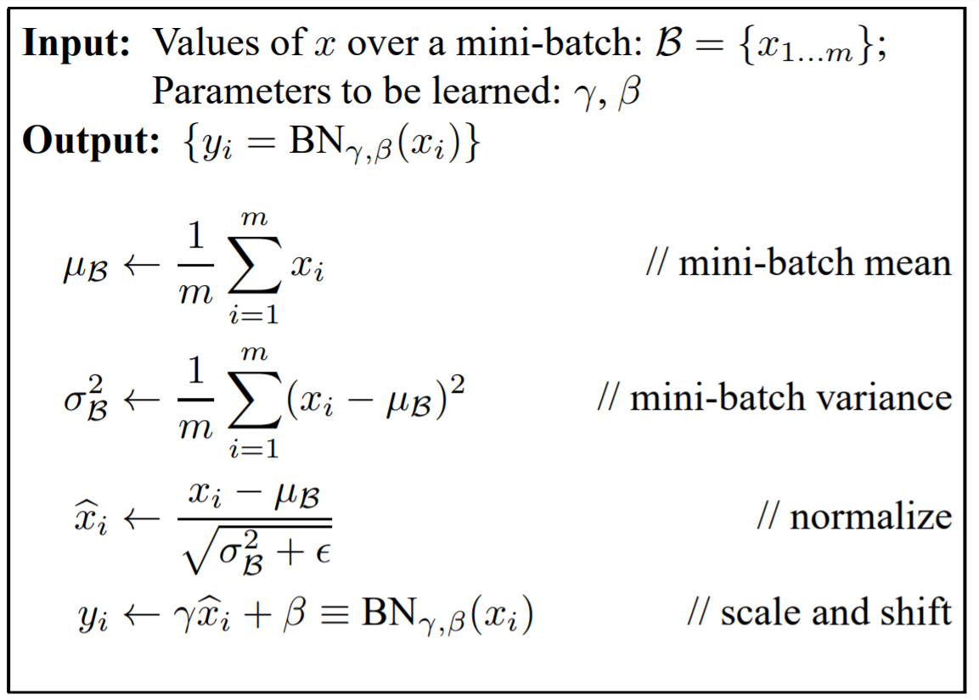
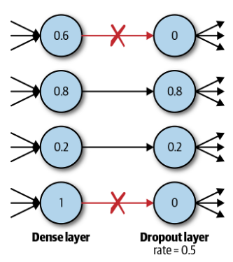
Background
Batch Normalization
𝜇 = batch mean, σ = batch standard deviation, ε = small constant added to avoid divide by zero error, Γ = scaling factor, β = shifting factor.
Co-variance shifting (change in distribution of input data during training) that effects the weights leads to exploding gradient problem (loss function start returning NaN).
Dropout Technique
Overcome overfitting problem in neural network.
Regularization technique - model is penalized if it starts to overfit.
Ensure the network doesn’t become overdependent on certain neuron or groups of neurons.

Slide 8
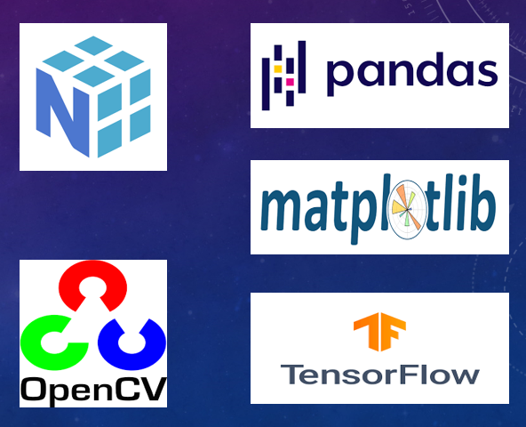
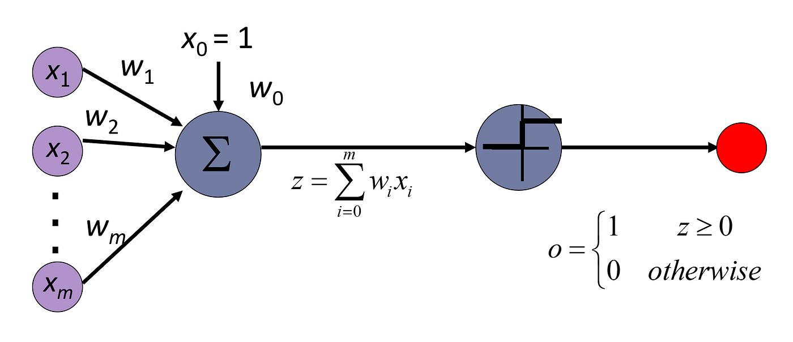
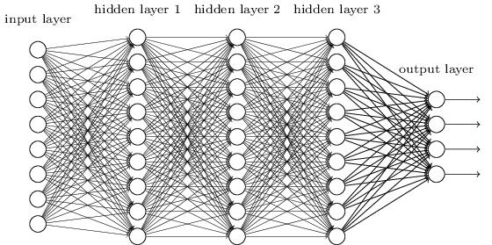
Background
Artificial Neural Network (ANN) and Deep Learning

Slide 9
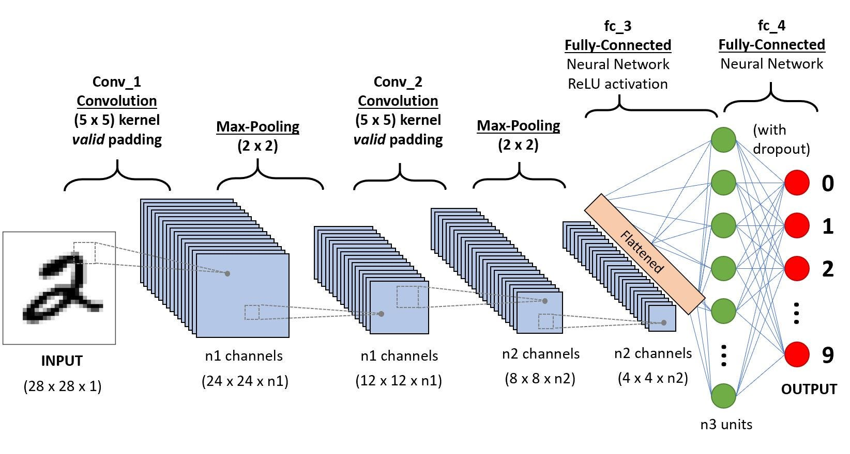
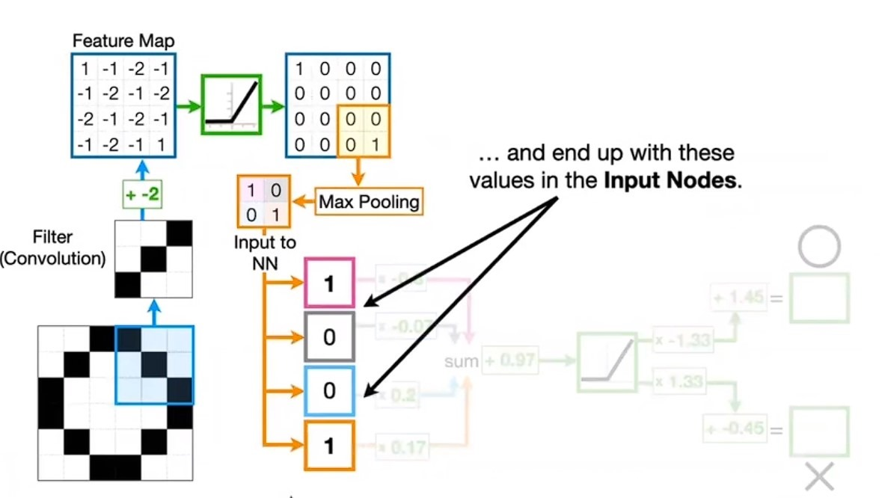
Background
Convolution Neural Networks (CNN)

Slide 10
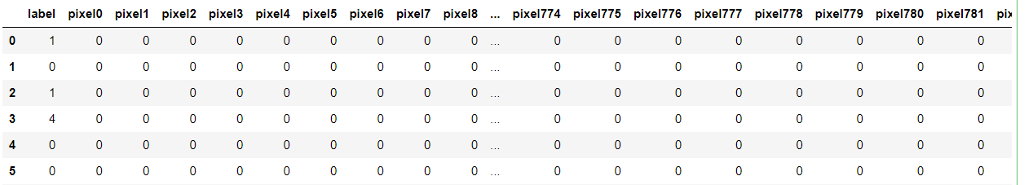
Data Extraction and Exploratory Analysis
Obtained from Kaggle (MNIST Handwritten Digits Dataset)
42K and 28K rows (observations) respectively for train and test.
One target named ‘label’ with values from 0-9 and 784 features from pixel0 to pixel783
Each sample represent a digit image with size 28X28 (= 784)
Pandas – read_csv()

Slide 11
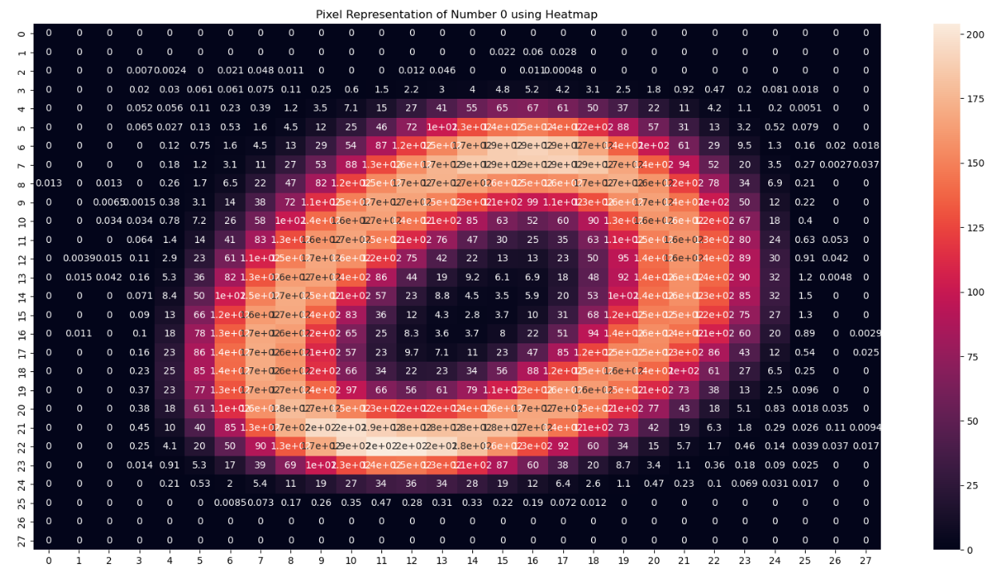
Data Extraction and Exploratory Analysis

Slide 12
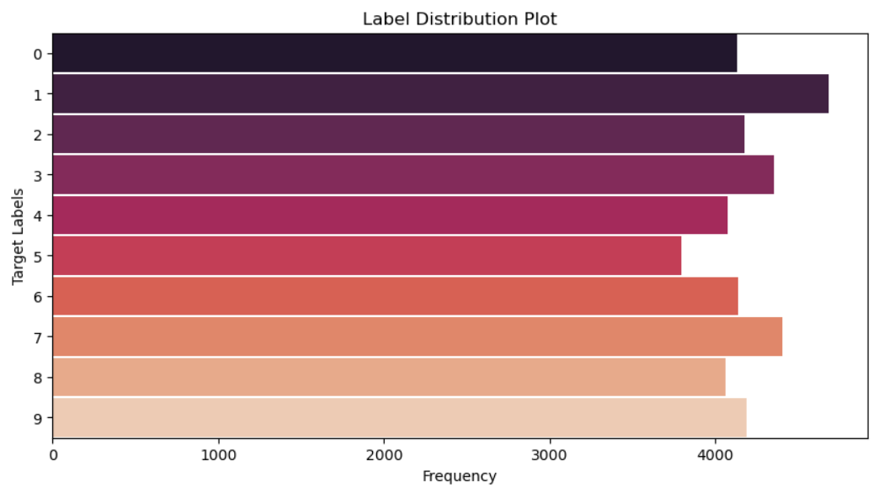
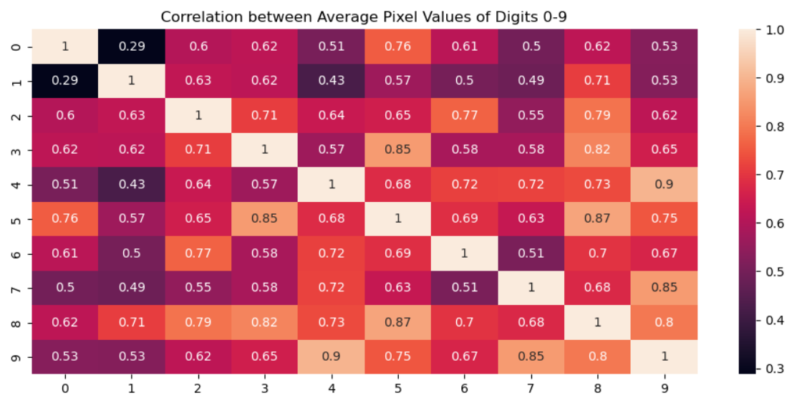

Data Extraction and Exploratory Analysis

Slide 13
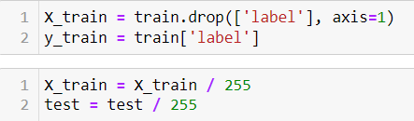
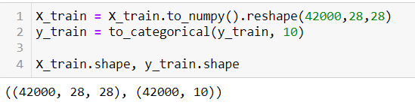
Data Preprocessing
Data Validation and Cleansing
No null values as well as duplicates.
Normalization of Pixel Values
255 represent white color and 0 represent black color, (0-255) represents intensity range of colors between black and white in gray-scale image.
Scaling the pixel values between 0 and 1 by dividing by 255.
Reshaping and One-Hot Encoding
Reshaping 784 pixel-valued columns into 28x28 that represent an image.
One-hot encoding the categorical target labels, a suitable format for neural networks.

Slide 14
Model Selection and Development
Deep Learning – Multi-layers ANN and Convolution Neural Network (CNN)
Non-Linearity – capable of learning complex (non-linear) relationships within data. Images often contains such complex patterns.
Feature Learning - automatically learn relevant features from raw image data by adjusting internal weights.
Adaptability - adapt to changes in image appearance due to lighting, rotation, and other transformations during learning process.
Developed Three Models: Multi-Layered NN Model, CNN Model, CNN with Batch Normalization and Dropout Layers

Slide 15
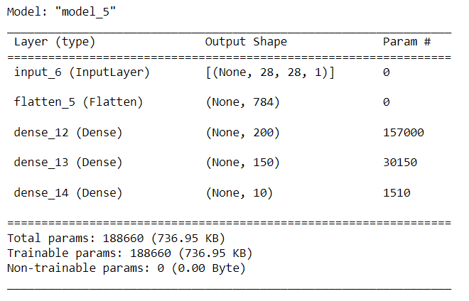
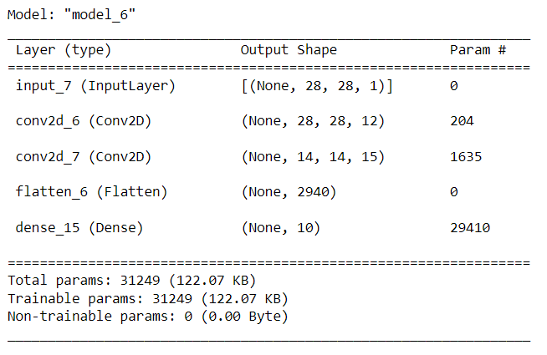
Model Selection and Development
MODEL1
MODEL2

Slide 16
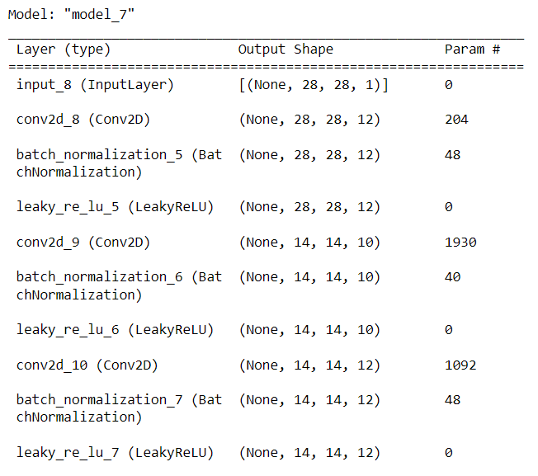
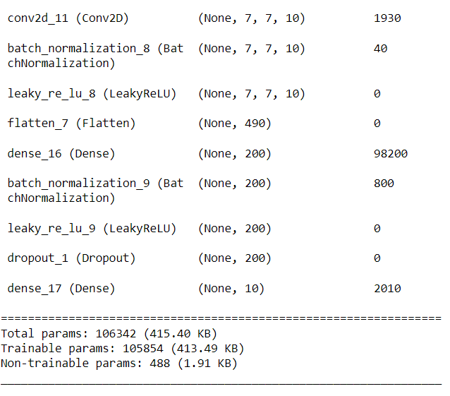
Model Selection and Development
MODEL3

Slide 17
Training and VALIDATION
Before training model, the developed model is compiled with loss function, optimizer and evaluation metrics.
Loss function as categorical_crossentropy, optimization function as Adam optimizer (learning_rate=0.06), and accuracy as a metric for evaluation.
Each model was then trained with batch_size = 32, number_of_epochs=10, validation_split=0.1
Training time for Model1, Model2, and Model3 were 41s, 138s, and 315s respectively.
Model3 took relatively larger time for training because it has higher number of hidden layers with variations like Batch Normalization and Dropout Layers.

Slide 18
Data Visualization
Accuracy and Loss Curves
Test Data Prediction Visualization
Confusion Matrix using Heatmap
Training versus Predicted

Slide 19
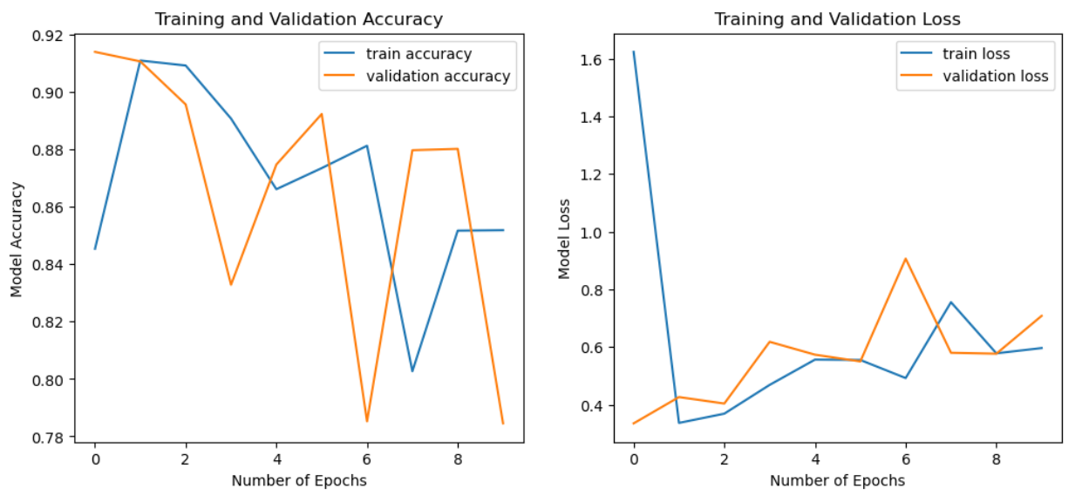
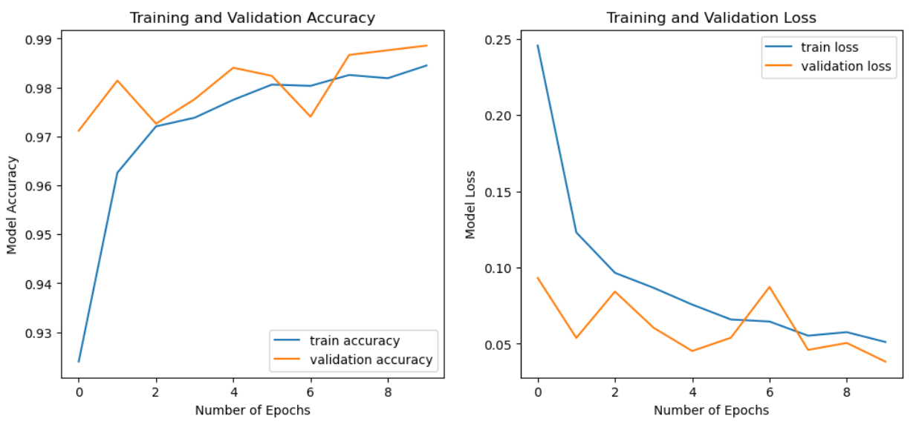
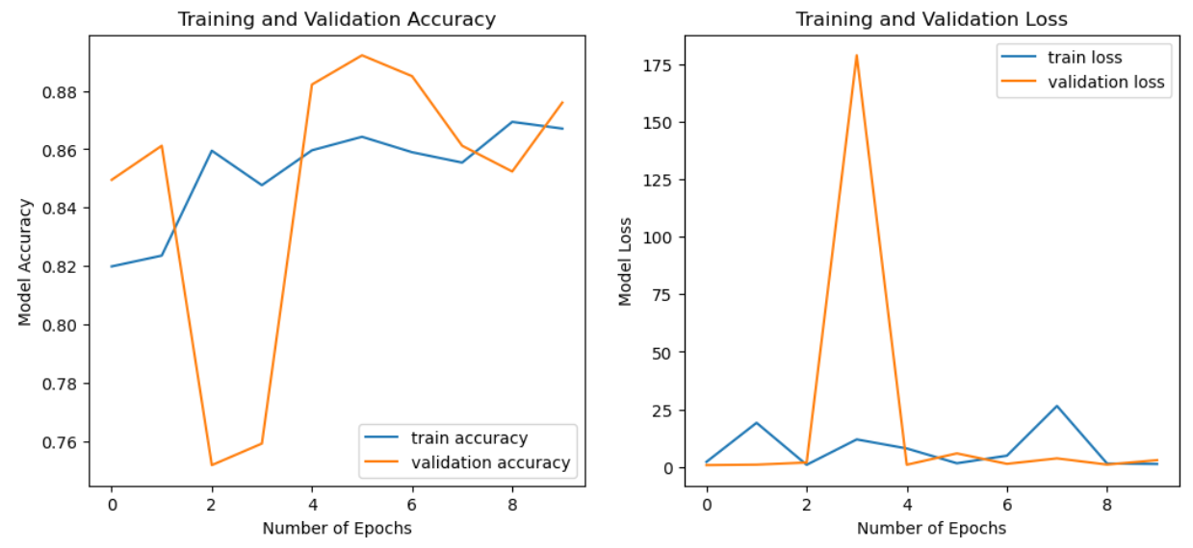
Data visualization – Accuracy and Loss Curves
MODEL3
MODEL2

Slide 20
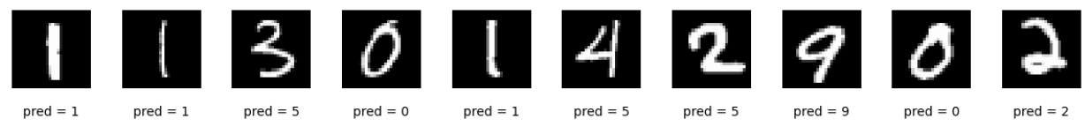
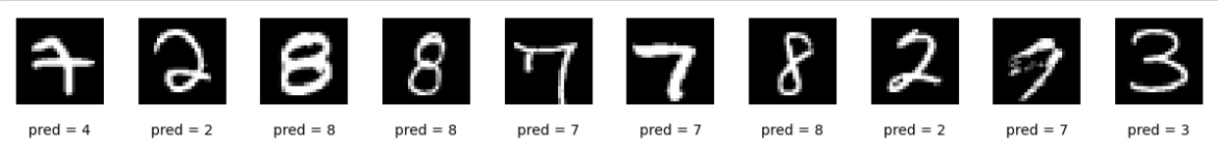
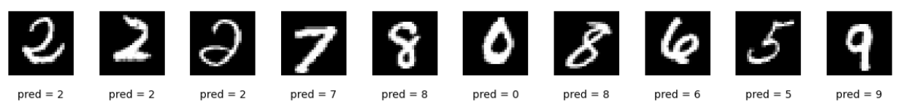
Data Visualization – Prediction Visualization
Model1
Model2
Model3

Slide 21
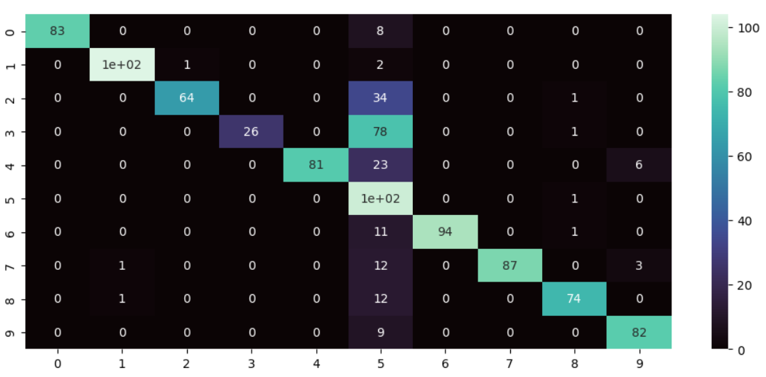
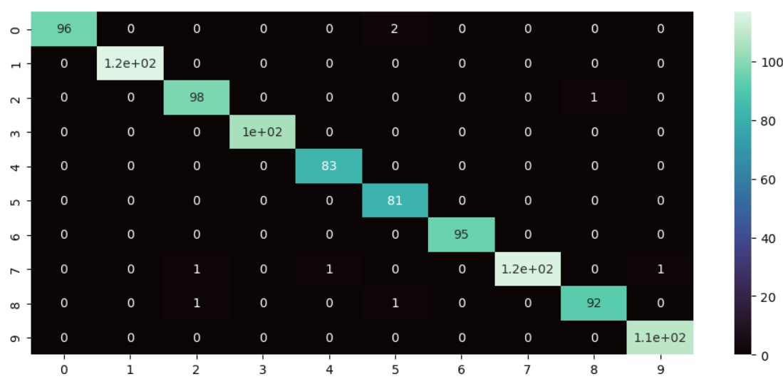
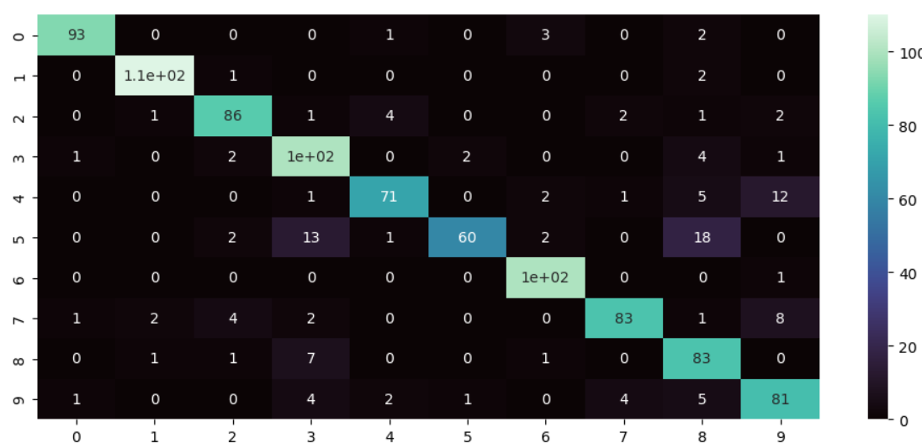
Data Visualization – Confusion Matrix
M
O
D
E
L
1
Number of random samples taken for confusion matrix construction = 1000
M
O
D
E
L
3
M
O
D
E
L
2

Slide 22
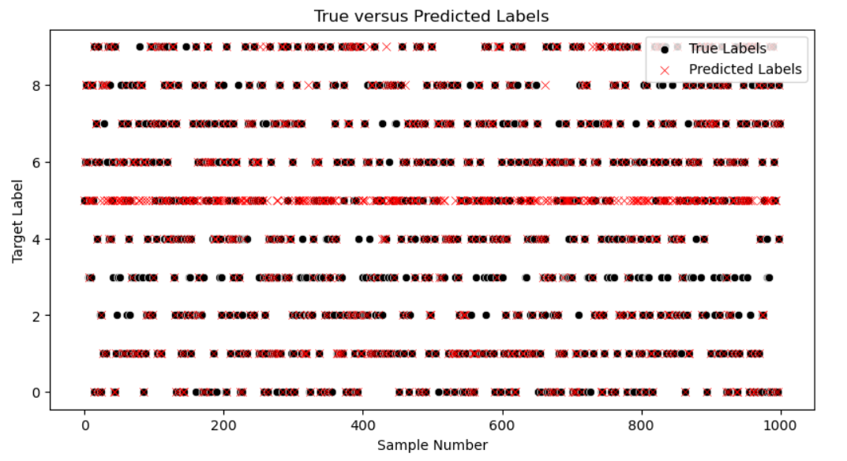
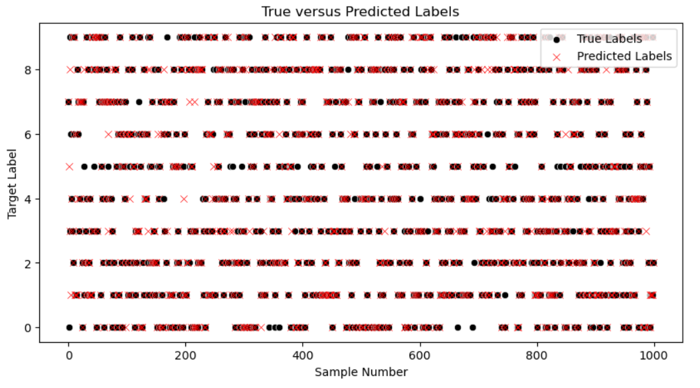
Data Visualization – Actual vs. Predicted
MODEL1
MODEL2

Slide 23
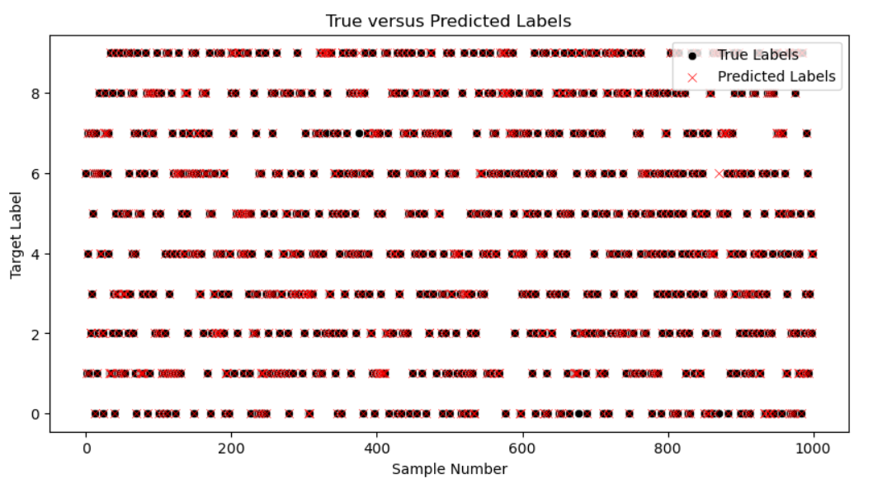
Data Visualization – Actual vs. Predicted

Slide 24
Results and Discussion
After complete 10 epochs, the training accuracy were 85%, 87% and 98.5% for models Model1, Model2, and Model3 respectively.
While validation accuracy were 78%, 88%, and 99% for respective models. Model3 has significantly lower training and validation loss.
Model3 was most accurate, stable and effective in terms of convergence as well.
Obtained accuracy (98.5%) is quite good in real-field applications. Also, incorporating batch normalization and dropout layer in CNN model, its performance improved significantly.
MODEL1
MODEL2
MODEL3

Slide 25
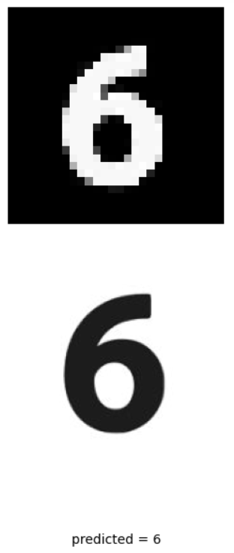
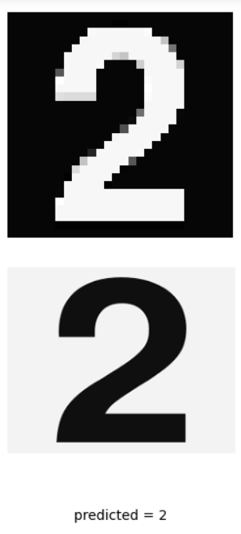
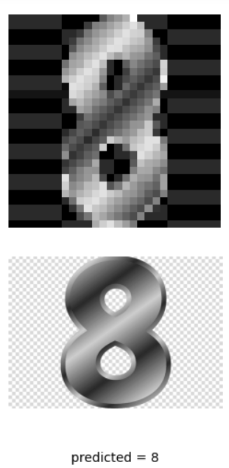
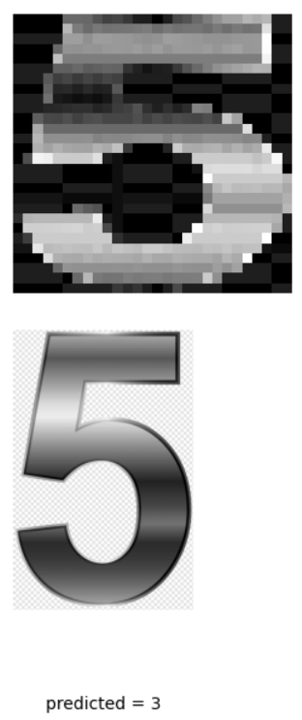
DEMO WORKS
Before using model in real-case scenario, the model is saved locally. For this, pickle library is used. Using pickle.dump(), pickle.load() and filename as "digit_recognition_model.pkl"
Testing Model on Image Downloaded from Google

Slide 26
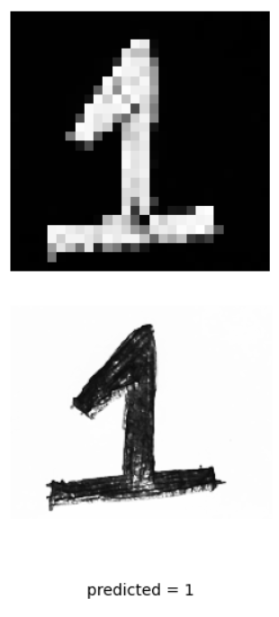
Testing Model on Self Handwritten Digit
cv2.imread(img_path)
Converted the image into gray scale using cv2.cvtColor()
Resized the image to 28X28 using cv2.resize()
Reverted image color using cv2.bitwise_not()
~ (255 – resized_image)
Loaded_model.predict(reverted_image)

Slide 27
Conclusion and Future Works
Model with Batch Normalization and Dropout Layering has improved convergence and better training stability and accuracy (~99%).
Model has improved generalization on new unseen data.
FUTURE WORKS
Explore Advanced Architectures - ResNet, DenseNet, or EfficientNet, to further enhance accuracy and feature extraction capabilities.
Apply Ensemble Methods for robustness.
Hyperparameter Tunning – find optimal settings for model.
Real-Time Implementation - a real-time digit recognition system using techniques like object detection and camera integration.

Slide 28
References
AstroDave, & Will Cukierski. (2012). Digit Recognizer. Kaggle. https://kaggle.com/competitions/digit-recognizer
R. Kanniga Devi; G. Elizabeth Rani. (2019). A Comparative Study on Handwritten Digit Recognizer using Machine Learning Technique. 2019 IEEE International Conference on Clean Energy and Energy Efficient Electronics Circuit for Sustainable Development. Krishnankoil, India: IEEE. https://ieeexplore.ieee.org/abstract/document/9167748
Renata F. P. Neves; Alberto N. G. Lopes Filho; Carlos A.B. Mello; Cleber Zanchettin. (2011). A SVM based off-line handwritten digit recognizer. 2011 IEEE International Conference on Systems, Man, and Cybernetics. Anchorage, AK, USA: IEEE. https://ieeexplore.ieee.org/abstract/document/6083734
Foster, D. (2019). Generative Deep Learning. 1005 Gravenstein Highway North, Sebastopol: O’Reilly Media, Inc.
Keras. (n.d.). Getting started with the Keras functional API. https://keras.io/getting_started/
Matplotlib. (n.d.). Tutorials. https://matplotlib.org/stable/tutorials/index

